Slide 1

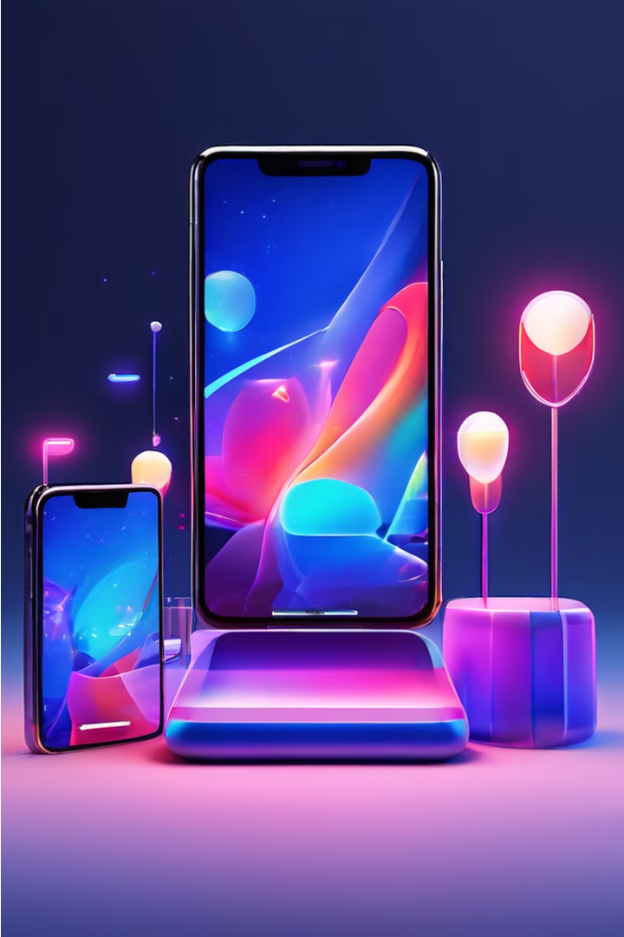
Flipkart Mobile Sales Overview
Flipkart, India's leading e-commerce platform, has become a hub for mobile device sales, offering customers a wide selection of smartphones from top brands. This presentation delves into the key insights and trends that shape Flipkart's mobile sales landscape.
By Amit Ghosh

Slide 2
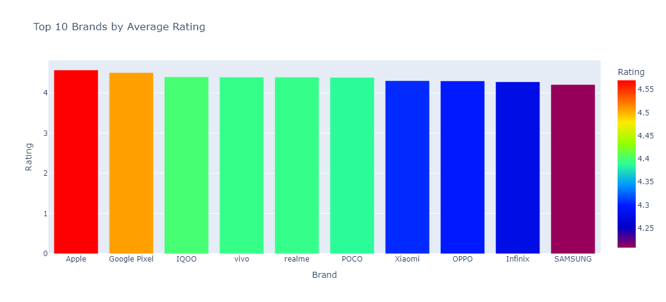

Top 10 Brands Upon Customer Ratings

Slide 3
Top 3 Brands Upon Customer Ratings
Top Brands
Customer Ratings
Insights
The most popular (Top Three) mobile brands on Flipkart
Customers on Flipkart have provided valuable feedback, with high-rated brands like IQOO, Vivo, and Apple consistently receiving reviews for their product quality, performance, and user experience.
By analyzing the intersection of top brands and customer ratings, Flipkart can better understand consumer preferences and tailor its offerings to meet the evolving needs of its user base.
Apple Rating = 4.6
Google Pixel = 4.55
IQOO = 4.4

Slide 4
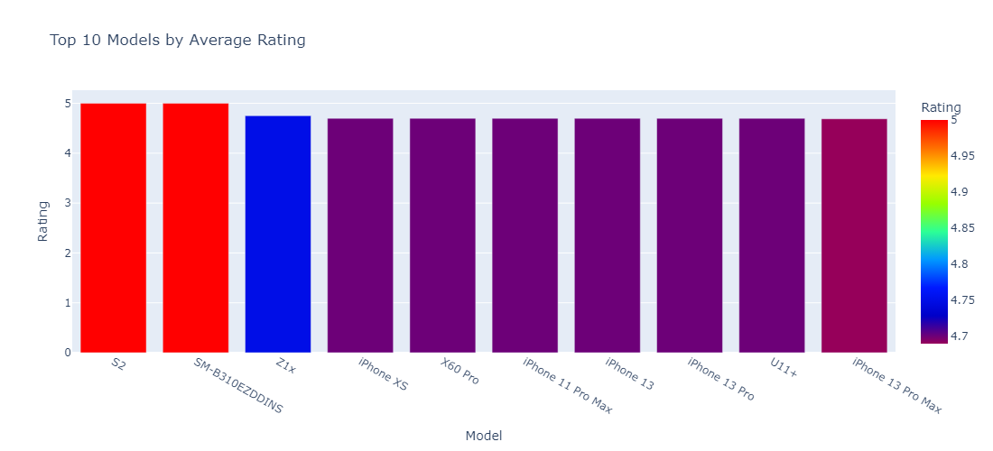
Top 10 Models Upon Customer Ratings

Slide 5
Top Models Upon Customer Ratings
Top Models
Customer Ratings
Insights
The most popular (Top Three) mobile brands on Flipkart
Customers on Flipkart have provided valuable feedback, with high-rated brands like Vivo, and Apple consistently receiving excellent reviews for their product quality, performance, and user experience.
By analyzing the intersection of top brands and customer ratings, Flipkart can better understand consumer preferences and tailor its offerings to meet the evolving needs of its user base.
1) Vivo(S2) & Samsung(SM-B310EZDDINS) = 5
2) Vivo(Z1x) = 4.75
3) Apple(iphone xs, iphone 11 Pro max,
iphone 13, iphone pro),
Vivo(X60 Pro) = 4.7
4) Apple(iphone 13pro max) = 4.68

Slide 6
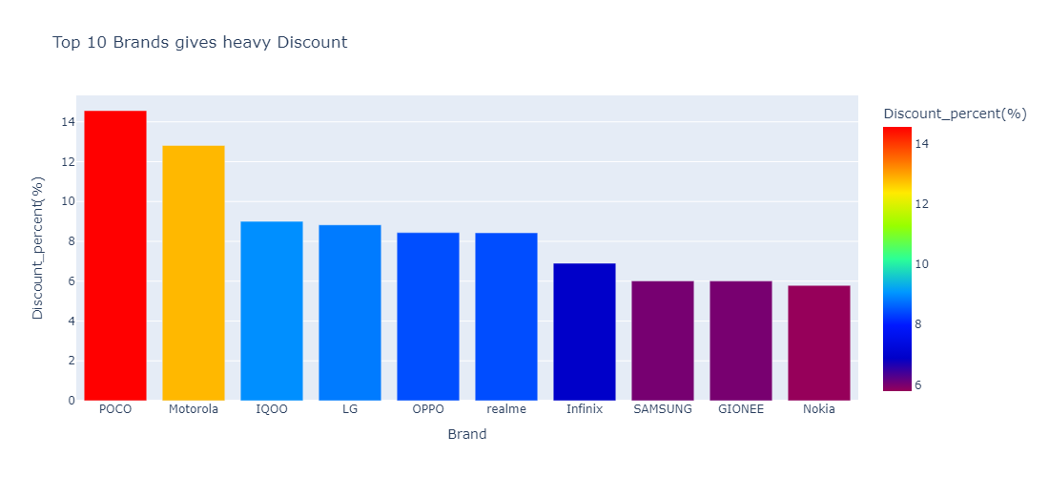
Discounts Offered by Brands

Slide 7
Discounts Offered by Brands
1
POCO Discounts (14.56%)
2
Motorola Discounts (12.9%)
POCO known for its value-focused offerings, frequently provides significant discounts on its popular smartphones.
Motorola leverages its strong market presence to offer attractive discounts and bundle deals, especially on its mid-range and flagship models.
3
IQOO Discounts (9%)
4
OPPO Discounts (14.56%)
IQOO rising star in the Indian smartphone market, often introduces limited-time offers and flash sales to drive sales and capture a larger market share.
Oppo, with its focus on camera-centric smartphones, consistently provides competitive pricing and bundle offers to entice customers on Flipkart.

Slide 8



Pricing Trends: Expensive vs. Budget Brands
High Range Brands:
OPPO
HTC
Google Pixel
LG
ASUS
Nokia
Apple
SAMSUNG
Motorola
Xiaomi
Vivo
Mid Range Brands:
IQOO
Realme
GIONEE
Lenovo
POCO
Low Range Brands:
Infinix
Flagship Segment
Premium brands like Apple, Samsung, and Google Pixel command higher prices for their flagship models, catering to customers seeking the latest cutting-edge technology and features.
Mid-Range Segment
Brands like IQOO, POCO, and Lenovo have carved out a strong presence in the mid-range segment, offering a compelling balance of performance and affordability.
Budget Segment
Brands like Infinix have found success in the budget-friendly segment, providing high-value smartphones that cater to cost-conscious customers.

Slide 9
Conclusion and Key Takeaways
Top Brands
Customer Ratings
Discounts
Pricing Trends
Apple
Vivo, Samsung
POCO
Flagship, Mid-Range, Budget
Flipkart's mobile sales landscape is characterized by a diverse array of top brands, customer preferences, and pricing strategies. By understanding these key insights, Flipkart can optimize its offerings, cater to evolving consumer needs, and maintain its position as a leading e-commerce platform for mobile device sales.

